Slide 1
VLSI Design Methodology
电子科学与技术系：陈 松
2015年9月17日
Course Webpage: http://staff.ustc.edu.cn/~songch/da-ug.htm

Slide 2
Outline
Structured Design
  Hierarchy
  Regularity
  Modularity
  Locality
Design Partitioning
Design Methods/Styles
Design Flow (Cell-based Design)

Slide 3
Modern VLSI Design(SoC)
Coping with complexity
  How to design System-on-Chips?
    Many millions (even billions!) of transistors
    Tens to hundreds of engineers
  Structured Design
  Design Partitioning
Not designing an individual transistor

Slide 4
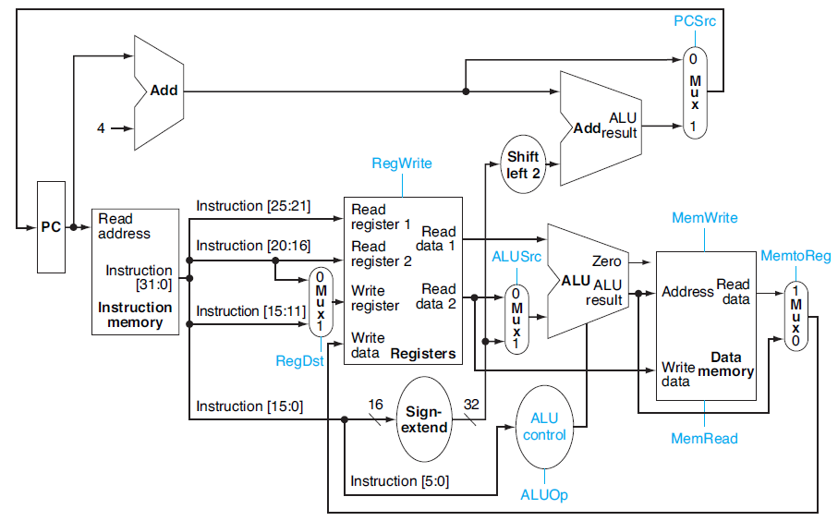
A Simple MIPS Architecture

Slide 5
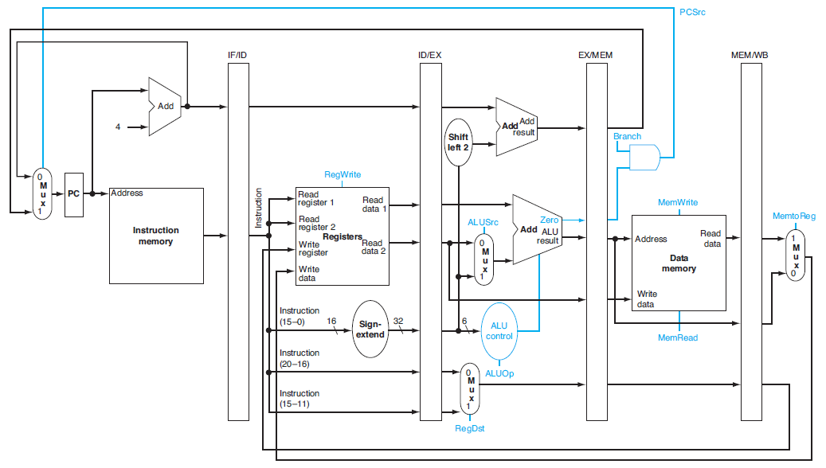
Pipelined MIPS Architecture

Slide 6
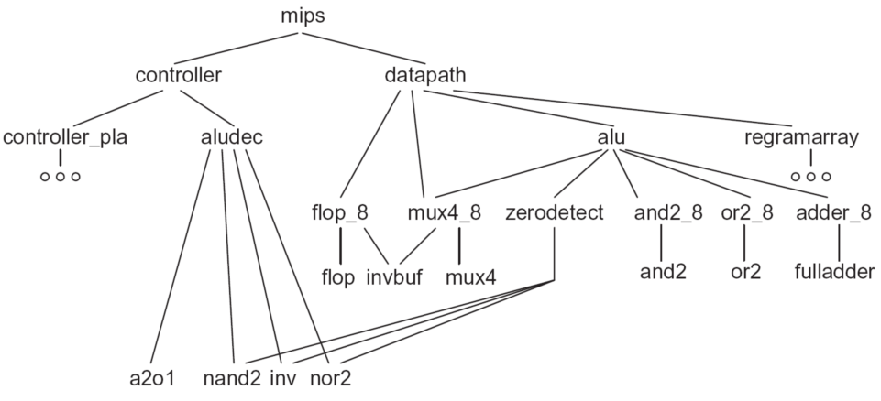
A MIPS CPU Design Hierarchy

Slide 7
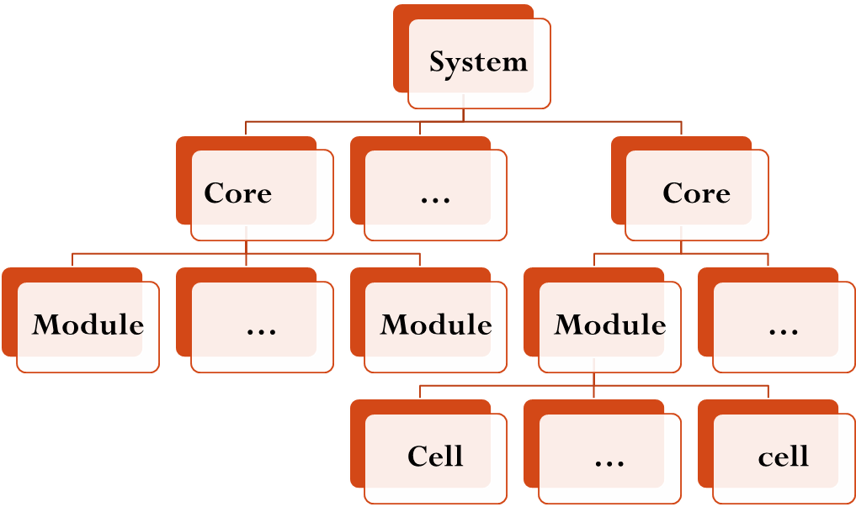
Structured design
Managing system complexity
  Hierarchy

Slide 8
Structured design (Cont’)
  Regularity : few modules
    Circuit level: uniformly sized transistors
    Gate level: a finite library of fixed-height, variable-length logic gates
    Logic level: parameterized RAMs and ROMs
    Architecture level: multiple identical processors

Slide 9
Structured design (Cont’)
  Modularity: well defined modules, IP sources
    Clear defined behavioral, structural, physical interface
      Function
      Name
      Signal type
      Electrical and Timing constraints of ports
      Position, connection layer, wire width
  Locality
    Local scoping: reducing the global variables
    Temporal, Physical

Slide 10
Structured design -Summary
Design Principle | Software | Hardware
Hierarchy | Subroutines, libraries | Modules
Regularity | Iteration, code sharing, object-oriented procedures | Datapaths, module reuse, regular arrays, gate arrays, standard cells
Modularity | Well-defined subroutine interface | Well-defined module interaces, timing and loading data for modules, registered inputs and outputs
Locality | Local scoping, no global variables | Local connections through floorplanning

Slide 11
Design Partitioning - Design Abstractions
  Architecture: User’s perspective, what does it do?
    Instruction set, registers, memory model
    MIPS, x86, Alpha, PIC, ARM, …
  Microarchitecture
    Single cycle, multicycle, pipelined, superscalar?
    80386, 80486, Pentium, Pentium II, Pentium III, AMD Athlon, …
  Logic: how are functional blocks constructed
    Ripple carry, carry lookahead, carry select adders
  Circuit: how are transistors used
    Complementary CMOS (CMOS), pass transistors, domino
  Physical: chip layout
    Datapaths, memories, random logic
Functionality,
Performance,
Power,
Area, etc.

Slide 12
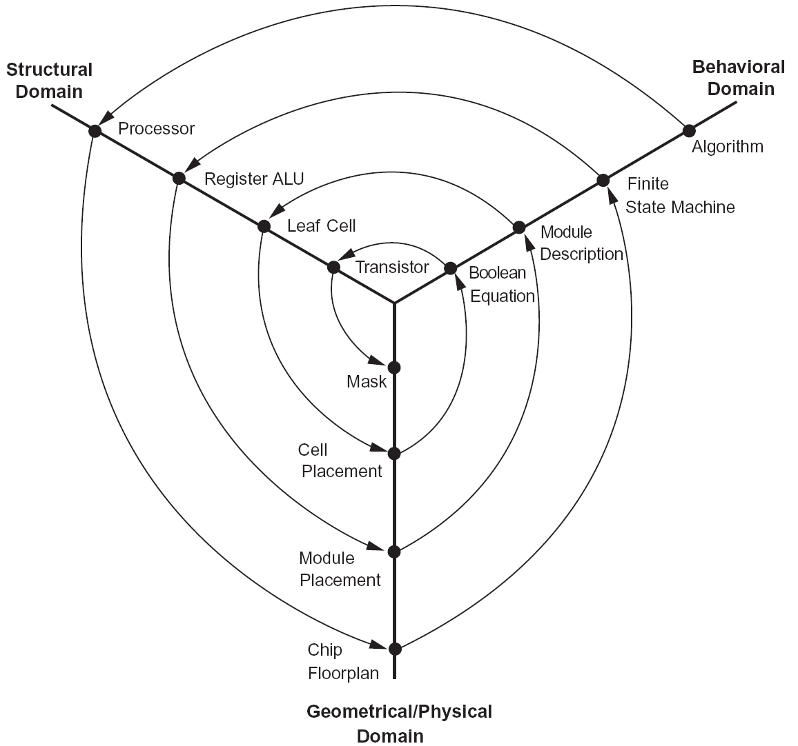
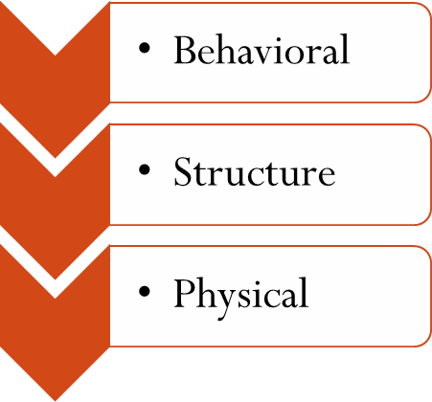
Design Partitioning
Design Flow:
Notes:
D. Gajski and R. Kuhn, New VLSI Tools, Computer, vol.16, no.12, Dec.1983, pp.11-14

Slide 13
Design Methods
Microprocessor/DSP
Programmable Logic
  Programmable Logic Devices
  Field-Programmable Gate Arrays (FPGAs)
Gate Array and Sea of Gates Design
Cell-Based Design
Full Custom Design
Platform-Based Design-System on a Chip
Select the right solution: Costs,
Capabilities,
Limitations,

Slide 14
FPGA

Slide 15
Simple FPGA Logic Cell

Slide 16
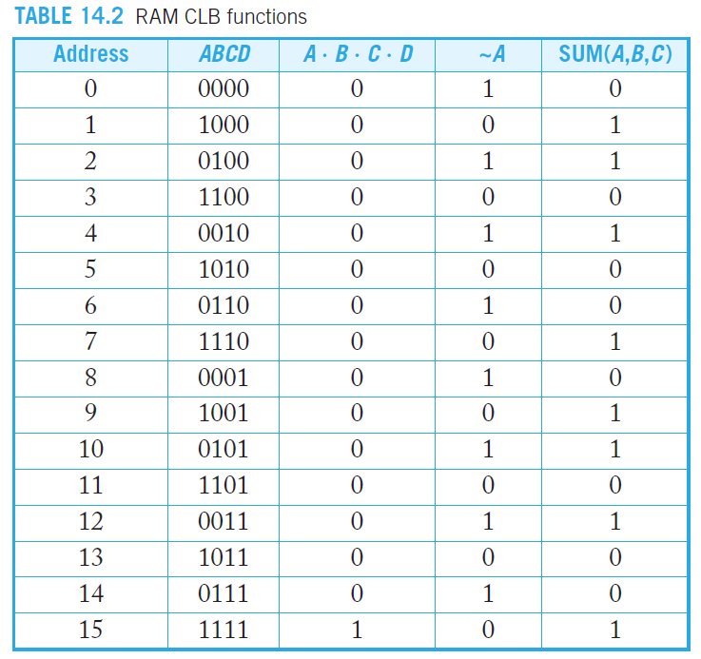
RAM CLB Functions

Slide 17
FPGA – A Summary
Chip is still there
  Millions of logic gate
  >10GHz I/Os
Embedded microprocessor cores and DSP accelerator hardware
Low up-front cost and ease of correcting design errors
  Best choice now for many low- to medium- volume custom logic applications
Implement FPGA blocks on any CMOS chip
  to provide programmability at the gate level

Slide 18
Cell-based Design
Use a standard cell library
  Small-scale integration logic
    NAND, NOR, XOR, AOI, OAI, inverters, buffers, registers
    Memories (RAM, ROM, CAM, register files)
    System-level modules such as processors, protocol processors, serial interfaces, and bus interfaces
    Possibility of mixed-signal and RF modules
  Minimum Scale Integration: adders, multipliers, parity blocks

Slide 19
Typical Standard Cell Library
Gate Type | Variations | Options
Inverter/Buffer/Tristate Buffer |  | Wide range of power options, 2^{^0-6}x minimum size inverter
NAND/AND | 2-8 inputs | High, normal, low power
NOR/OR | 2-8 inputs | High, normal, low power
XOR/XNOR |  | High, normal, low power
AOI/OAI | 21,22 | High, normal, low power
Multiplexers | Inverting/noninverting | High, normal, low power
Latches |  | High, normal, low power
Flip-Flops | D, with and without synch/asynch set and reset, scan | High, normal, low power
I/O Pads | Input, output, tristate, bidirectional, boundary scan, slew rate liminted, crystal oscillator | Various drive levels (1-16mA) and logic levels

Slide 20
Standard cell layout

Slide 21
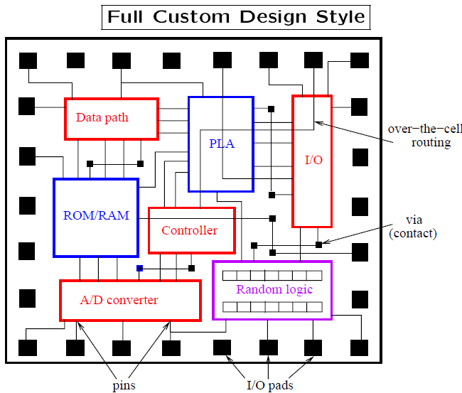
Full Custom Design
Custom-designed microprocessors
  >2GHz
Synthesized ASIC
  200-350MHz
  3-7x more power
  2.6x if better tools
  and cell libraries.

Slide 22
Design Styles
Custom and Semi-Custom
  Hand-drawn transistors (+ some standard cells)
  High volume, best possible performance: used for most advanced microprocessors
Field-Programmable Gate Arrays
  Transistors have been there, you configure the functions and connections
  Prototyping
  Low volume, low-moderate performance applications
Standard-Cell-Based ASICs
  High volume, moderate performance: Graphics chips, network chips, cell-phone chips

Slide 23
Platform-based Design – System on a Chip
Use of predefined IP blocks has become commonplace
  RISC processors, memory, I/O functions, common buses, NoC
  High-level languages to program
  Typically, a basic RISC processor, extended with multipliers, floating point units, or specialized DSP units, special hardware assisted instructions, etc.
What you need do
  Put the blocks together
  Design any application-specific blocks
  Place and route a correctly operational chip

Slide 24
Design Method Summary
Design Method | Non-Re-curring En-gineering | Unit Cost | Power Dissipation | Complexity of Implementation | Time-Market | Performance | Felxibility
Microprocessor/DSP | Low | Medium | High | Low | Low | Low | High
PLD | Low | Medium | Medium | Low | Low | Medium | Low
FPGA | Low | Medium | Medium |  | Low | High | High
Cell-based | High | Low | Low | High | High | High | Low
Custom Design | High | Low | Low | High | High | Very High | Low
Platform-Based | High | Low | Low | High | High | High | Medium

Slide 25
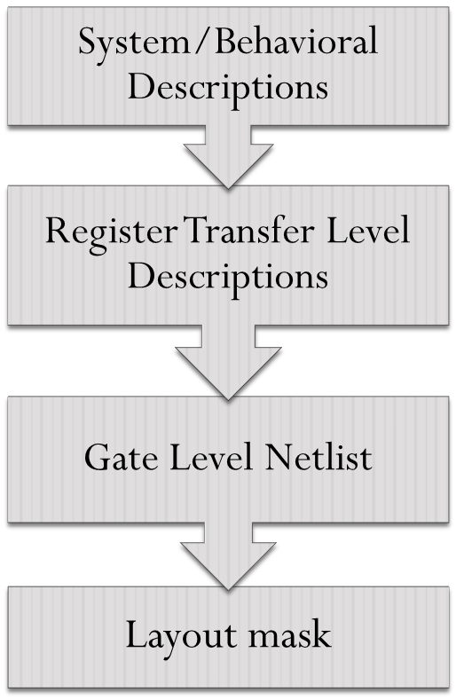
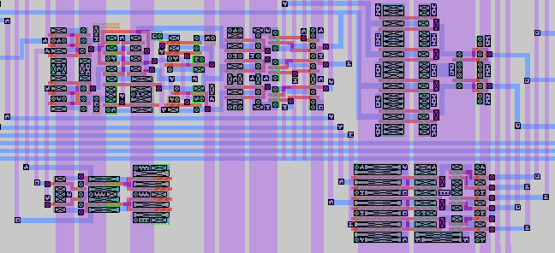
ASIC (专用集成电路 )
X = A + B;
E = X * D;
F = (B + C) * X;
Design Automation
D
A
B
C
Scheduling;
Binding;
Allocation.
＋
X
＋
＊
Y
High-level Synthesis
高层次综合
E
＊
F
A
B
C
D
X
Y
＋
＊
Logic Optimization;
Technology Mapping.
E
F
Adder 1 Multiplier 1
Register 8 Multiplexer 4
Logic Synthesis
逻辑综合
A
B
Floorplanning;
Placement;
Routing;
etc.
Physical Synthesis
物理综合/
芯片布图

Slide 26
High-level Synthesis (高层次综合)
Transformation from a behavioral specification of a system to its RTL structure specification
  E.g., from C/C++ to RTL, Bluespec, Xilinx AutoESL
  Promote the productivity
  Essential tasks: scheduling, binding, allocation
begin
done = 0; A = inA; B = inB;
while ( !done )
begin
if ( A < B )
swap = A;
A = B; B = swap;
else if ( B != 0 )
A = A - B;
else
done = 1;
end
A
sel
A
en
B
sel
B
en
B = 0
A < B
zero?
lt
A
sub
B

Slide 27
Logic Synthesis (逻辑综合)
Transformation from a Register-Transfer-Level (RTL) description to a gate-level netlists
  Hardware Description Language
    Verilog HDL, VHDL
  Logic Optimization
  Technology Mapping

Slide 28
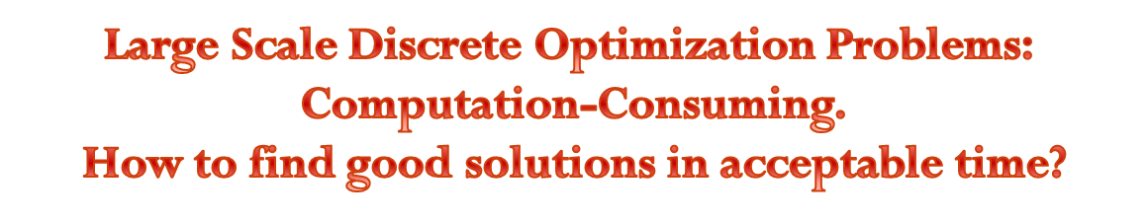
Physical synthesis(物理综合)
Transformation from a gate-level netlists to its physical layouts (masks)
  Partitioning (划分)
  Floorplanning （布图规划）
  Power/Ground Network Synthesis （电源线/地线网络合成）
  Placement （布局）
  Routing （布线）：Clock Tree, Signal, Power/Ground
  Post-routing （后布线优化）
    Redundant Via Insertion (Design for Yield)

Slide 29






Performance, Power, Cost
提升性能是永恒的主题
保证性能的前提下降低成本
保证性能和功耗的前提下降低成本
提升性能必然
导致功耗上升
提升性能要求
增加资源，导
致成本上升
保证性能的前提下降低功耗
保证性能和成本的前提下降低功耗

Slide 30
References
Meil H. E. Weste and David Money Narris, "CMOS VLSI Design: A circuits and Systems Perspective", fourth edition, Addison-Wesley
  Chapter 14.
Further reading: Chapter 14.5 Design Economics

